Slide 1
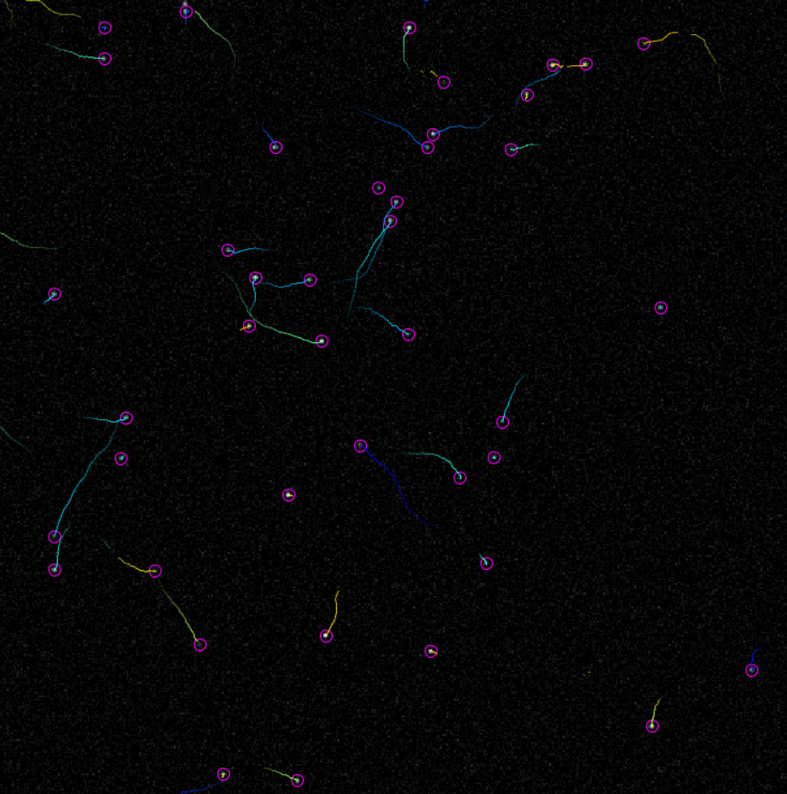
Introduction to Tracking Part 2

Slide 2
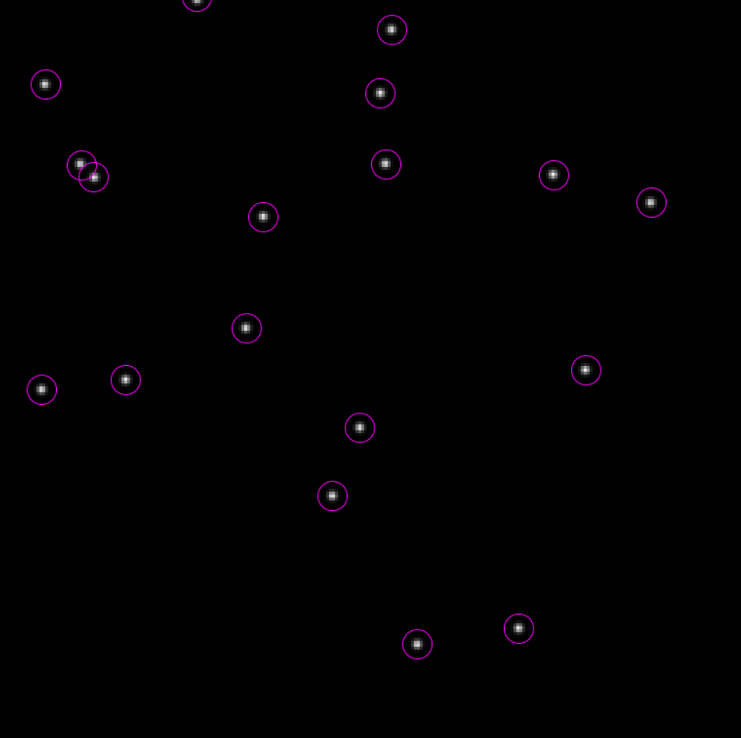
Object Detection
Detecting objects to be tracked

Slide 3
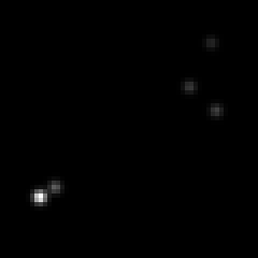
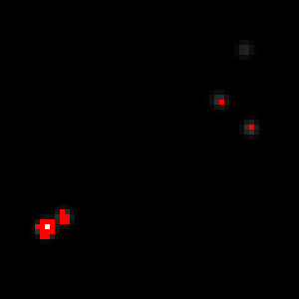
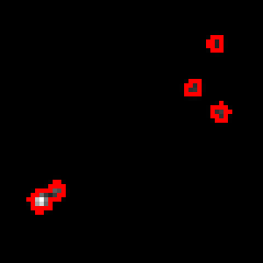
Can we segment particles this way?
If background is uniform and all exhibit similar intensity
Even then, not ideal:
Adjacent particles conjoined
Loss of localisation accuracy

Slide 4
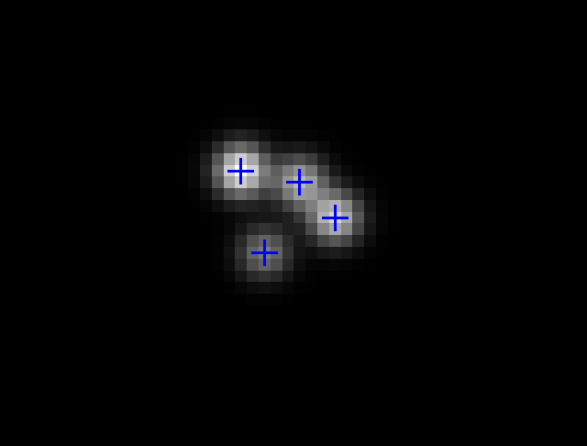
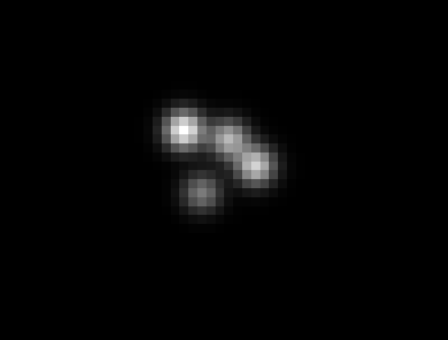
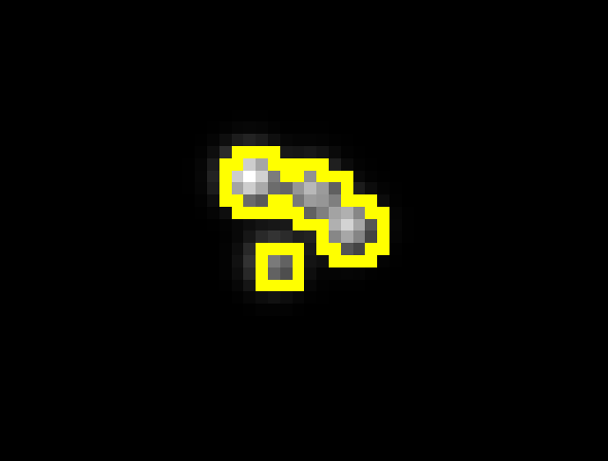
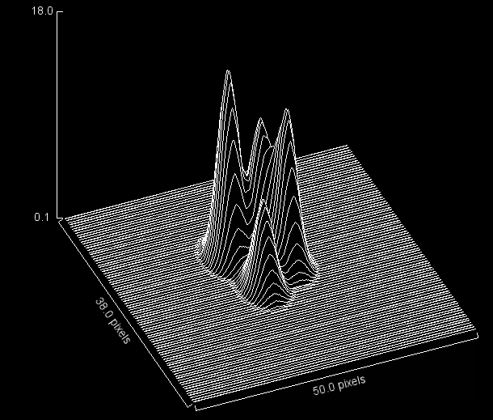
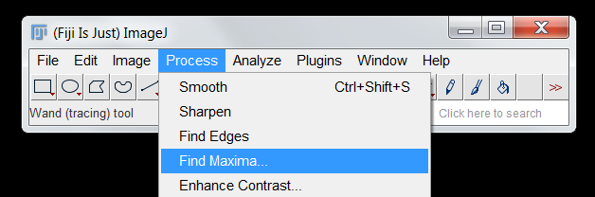
Local maxima detection

Slide 5
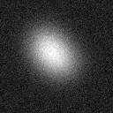
Gaussian Filtering is the basis for blob detection
For larger objects, a Laplacian-of-Gaussian (LoG) works quite well
Needs sufficient spatial resolution for edge detector
For smaller objects, a Difference-of-Gaussians (DoG) is better.
Rough approximation of LoG

Slide 6
Effect of LoG Filtering
33 | 21 | 54 | 25 | 36 | 24 | 31 | 8 | 19 | 50 | 22 | 18 | 15 | 25 | 25
17 | 34 | 13 | 26 | 31 | 43 | 31 | 23 | 37 | 26 | 34 | 25 | 20 | 44 | 32
26 | 33 | 23 | 17 | 27 | 24 | 32 | 37 | 34 | 28 | 36 | 49 | 34 | 36 | 31
23 | 18 | 44 | 22 | 49 | 38 | 42 | 34 | 25 | 41 | 29 | 39 | 30 | 36 | 28
12 | 24 | 27 | 17 | 42 | 30 | 30 | 20 | 34 | 29 | 44 | 29 | 24 | 26 | 47
37 | 30 | 38 | 1 | 29 | 26 | 41 | 84 | 22 | 29 | 30 | 41 | 33 | 6 | 31
20 | 36 | 23 | 18 | 30 | 29 | 65 | 83 | 72 | 29 | 4 | 35 | 34 | 30 | 34
47 | 30 | 29 | 16 | 23 | 46 | 75 | 84 | 81 | 44 | 28 | 31 | 15 | 23 | 41
24 | 43 | 22 | 0 | 25 | 31 | 65 | 83 | 58 | 39 | 18 | 30 | 31 | 16 | 29
27 | 47 | 40 | 37 | 29 | 34 | 46 | 40 | 48 | 30 | 11 | 40 | 27 | 29 | 13
53 | 30 | 23 | 28 | 36 | 20 | 41 | 30 | 29 | 18 | 40 | 37 | 28 | 18 | 42
24 | 51 | 23 | 31 | 28 | 26 | 18 | 29 | 34 | 43 | 50 | 23 | 28 | 29 | 36
41 | 46 | 29 | 32 | 23 | 34 | 36 | 29 | 30 | 24 | 6 | 34 | 39 | 32 | 27
25 | 24 | 22 | 14 | 21 | 33 | 27 | 41 | 26 | 27 | 29 | 49 | 38 | 32 | 37
44 | 33 | 23 | 28 | 34 | 58 | 22 | 15 | 38 | 50 | 15 | 22 | 26 | 29 | 35
34 | 35 | 38 | 39 | 38 | 37 | 33 | 33 | 34 | 33 | 34 | 37 | 33 | 28 | 25
35 | 37 | 38 | 37 | 37 | 37 | 36 | 36 | 37 | 35 | 36 | 37 | 34 | 30 | 25
38 | 37 | 36 | 36 | 35 | 33 | 31 | 31 | 33 | 33 | 34 | 37 | 37 | 34 | 30
35 | 34 | 35 | 35 | 32 | 27 | 21 | 19 | 20 | 23 | 28 | 33 | 37 | 38 | 35
33 | 34 | 35 | 34 | 27 | 17 | 10 | 7 | 8 | 11 | 19 | 28 | 33 | 35 | 35
36 | 37 | 37 | 32 | 20 | 7 | 2 | 3 | 2 | 3 | 11 | 23 | 31 | 34 | 34
37 | 38 | 37 | 28 | 13 | 2 | 3 | 13 | 8 | 0 | 6 | 19 | 30 | 35 | 36
35 | 35 | 34 | 24 | 10 | 2 | 10 | 29 | 16 | 1 | 5 | 18 | 30 | 36 | 38
37 | 36 | 32 | 22 | 11 | 4 | 10 | 17 | 8 | 0 | 6 | 20 | 31 | 37 | 39
37 | 38 | 32 | 23 | 14 | 7 | 5 | 4 | 2 | 3 | 12 | 24 | 33 | 38 | 39
35 | 37 | 35 | 27 | 19 | 12 | 8 | 6 | 7 | 12 | 20 | 30 | 36 | 38 | 37
34 | 35 | 36 | 31 | 25 | 20 | 18 | 17 | 19 | 23 | 29 | 35 | 38 | 38 | 37
34 | 34 | 36 | 35 | 31 | 29 | 27 | 27 | 28 | 30 | 34 | 37 | 38 | 37 | 36
34 | 35 | 36 | 36 | 35 | 34 | 34 | 33 | 32 | 33 | 35 | 36 | 37 | 35 | 33
36 | 35 | 36 | 37 | 36 | 36 | 37 | 36 | 34 | 34 | 35 | 36 | 37 | 33 | 30

Slide 7
Effect of DOG Filtering
33 | 21 | 54 | 25 | 36 | 24 | 31 | 8 | 19 | 50 | 22 | 18 | 15 | 25 | 25
17 | 34 | 13 | 26 | 31 | 43 | 31 | 23 | 37 | 26 | 34 | 25 | 20 | 44 | 32
26 | 33 | 23 | 17 | 27 | 24 | 32 | 37 | 34 | 28 | 36 | 49 | 34 | 36 | 31
23 | 18 | 44 | 22 | 49 | 38 | 42 | 34 | 25 | 41 | 29 | 39 | 30 | 36 | 28
12 | 24 | 27 | 17 | 42 | 30 | 30 | 20 | 34 | 29 | 44 | 29 | 24 | 26 | 47
37 | 30 | 38 | 1 | 29 | 26 | 41 | 84 | 22 | 29 | 30 | 41 | 33 | 6 | 31
20 | 36 | 23 | 18 | 30 | 29 | 65 | 83 | 72 | 29 | 4 | 35 | 34 | 30 | 34
47 | 30 | 29 | 16 | 23 | 46 | 75 | 84 | 81 | 44 | 28 | 31 | 15 | 23 | 41
24 | 43 | 22 | 0 | 25 | 31 | 65 | 83 | 58 | 39 | 18 | 30 | 31 | 16 | 29
27 | 47 | 40 | 37 | 29 | 34 | 46 | 40 | 48 | 30 | 11 | 40 | 27 | 29 | 13
53 | 30 | 23 | 28 | 36 | 20 | 41 | 30 | 29 | 18 | 40 | 37 | 28 | 18 | 42
24 | 51 | 23 | 31 | 28 | 26 | 18 | 29 | 34 | 43 | 50 | 23 | 28 | 29 | 36
41 | 46 | 29 | 32 | 23 | 34 | 36 | 29 | 30 | 24 | 6 | 34 | 39 | 32 | 27
25 | 24 | 22 | 14 | 21 | 33 | 27 | 41 | 26 | 27 | 29 | 49 | 38 | 32 | 37
44 | 33 | 23 | 28 | 34 | 58 | 22 | 15 | 38 | 50 | 15 | 22 | 26 | 29 | 35
1 | 1 | 1 | 1 | 1 | 2 | 1 | 1 | 2 | 1 | 2 | 2 | 1 | 0 | 1
1 | 2 | 2 | 1 | 1 | 2 | 2 | 2 | 1 | 1 | 2 | 1 | 1 | 1 | 1
3 | 2 | 1 | 0 | 0 | 2 | 3 | 4 | 3 | 2 | 2 | 2 | 2 | 1 | 2
2 | 1 | 0 | 0 | 2 | 3 | 3 | 2 | 2 | 3 | 4 | 3 | 2 | 1 | 2
1 | 1 | 0 | 1 | 4 | 4 | 1 | 2 | 1 | 2 | 5 | 3 | 1 | 0 | 1
2 | 1 | 1 | 3 | 5 | 2 | 4 | 9 | 7 | 2 | 2 | 3 | 1 | 0 | 0
2 | 1 | 1 | 4 | 3 | 3 | 11 | 17 | 15 | 7 | 1 | 3 | 2 | 0 | 0
1 | 1 | 2 | 4 | 2 | 5 | 15 | 21 | 19 | 9 | 2 | 3 | 2 | 1 | 0
2 | 2 | 3 | 3 | 1 | 5 | 13 | 18 | 15 | 6 | 1 | 3 | 2 | 1 | 1
1 | 2 | 3 | 2 | 1 | 4 | 7 | 9 | 6 | 2 | 2 | 3 | 2 | 1 | 0
1 | 2 | 3 | 2 | 1 | 1 | 1 | 1 | 1 | 2 | 5 | 4 | 2 | 0 | 0
1 | 1 | 2 | 3 | 2 | 2 | 2 | 2 | 2 | 3 | 3 | 2 | 1 | 0 | 0
0 | 1 | 1 | 2 | 2 | 2 | 2 | 2 | 1 | 1 | 1 | 0 | 1 | 1 | 1
0 | 1 | 1 | 1 | 1 | 1 | 1 | 1 | 0 | 0 | 0 | 0 | 1 | 1 | 2
0 | 0 | 1 | 2 | 1 | 0 | 0 | 0 | 0 | 1 | 1 | 0 | 1 | 2 | 1

Slide 8
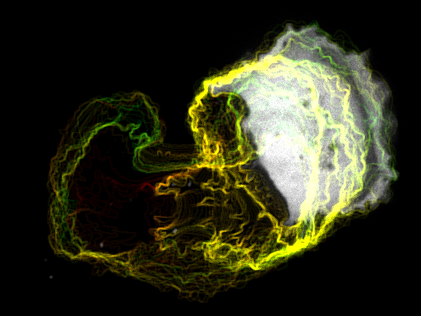
Tracking Cells
A few things to bear in mind

Slide 9
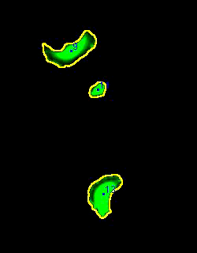
Implicitly tracks cells from frame to frame
Can deal with a certain amount of cell-cell contact
Morphology of cells can be measured at each frame
Frame rate needs to be high
High cell density will cause problems

Slide 10


Slide 12
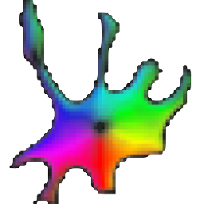
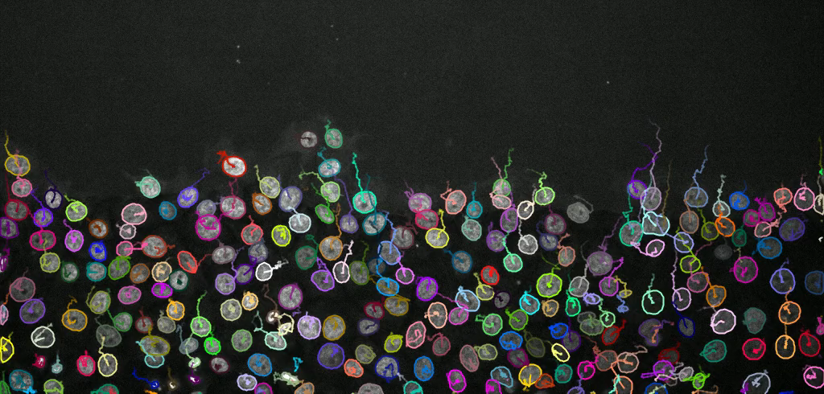

Other methods

Slide 13
Trajectory Construction
How do we link detections to make tracks?

Slide 14
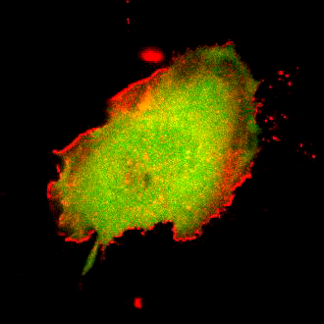
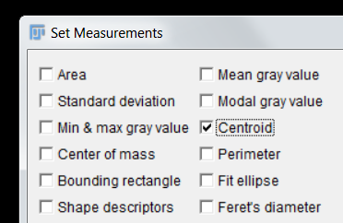

 | X | Y
1 | 54.714 | 52.262
2 | 55.046 | 52.466
3 | 55.197 | 52.539
4 | 55.134 | 52.602
5 | 54.971 | 52.858
6 | 54.894 | 53.022
7 | 54.339 | 53.402
8 | 53.569 | 53.593
9 | 53.22 | 54.242
10 | 53.125 | 54.075

Slide 15
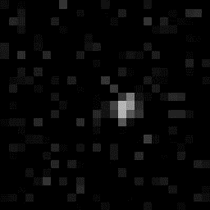

 | X | Y
1 | 14.5 | 12.5
2 | 15.5 | 12.5
3 | 15.5 | 12.5
4 | 13.5 | 12.5
5 | 14.5 | 13.5
6 | 13.5 | 13.5
7 | 14.5 | 13.5
8 | 13.5 | 14.5
9 | 13.5 | 14.5
10 | 14.5 | 14.5

Slide 16
What if you want to track more than one object?
Simplest is nearest neighbour approach
Works for sparse population and high frame rate
t2
t2
t1
t1

Slide 17
Joining the dots
Situation is usually more complicated
t1
t1
t1
t1
t1
t1

Slide 18
Joining the dots
Situation is usually more complicated
t2
t2
t2
t2
t2
t2

Slide 19
Joining the dots
Situation is usually more complicated
t3
t3
t3
t3
t3
t3

Slide 20
Joining the dots
Situation is usually more complicated
t3
t3
t1
t2
t2
t1
t3
t1
t3
t3
t2
t2
t2
t1
t2
t1
t1
t3

Slide 21

Let’s formalise this a little
Need information about particles to construct trajectories:
Minimum amount of info is coordinates:
P1 = (x₁, y₁), P2 = (x₂, y₂)
Think of this as the set of “features”
When constructing trajectories, evaluate differences between features:
$d=\sqrt{{(x_{2}−x_{1})}^{2}+{(y_{2}−y_{1})}^{2}}$
Trajectories are constructed in a way that minimises these differences
P1
t2
P2
t2
P2
t1
P1
t1

Slide 22

building trajectories works like so…
For each particle in frame 1:
For each particle in frame 2:
Compile features for each particle and calculate distance:
$d=\sqrt{{(x_{2}−x_{1})}^{2}+{(y_{2}−y_{1})}^{2}}$
Link particle in frame 2 with lowest value for d.
t2
10
t1
2
t1
t2
3
8

Slide 23
building trajectories works like so…
For each particle in frame 1:
For each particle in frame 2:
Compile features for each particle and calculate distance:
$d=\sqrt{{(x_{2}−x_{1})}^{2}+{(y_{2}−y_{1})}^{2}}$
Link particle in frame 2 with lowest value for d.
t2
10
t1
t1
t2
8

Slide 24
Multiple associations can quickly become computationally challenging
P3
t2
P3
t1
P3
t1
P1
t2
P3
t2
P2
t2
P1
t1
P2
t1
But, can eliminate the least probable links

Slide 25
Positional Information often insufficient
t3
t3
t2
t1
t1
t3
t2
t3
t1
t3
t2
t2
t2
t1
t2
t1
t1
t3

Slide 26
A Priori information can help in “busy” fields of view
For example, if motion is approximately linear and processive…
t3
t3
t2
t1
t1
t3
t2
t3
t1
t3
t2
t2
t2
t1
t2
t1
t1
t3

Slide 27
This is the basis for Kalman filtering
If motion is predictable, we can include “predicted” position as a feature
t1
t3
t1
t3
t2
t2
t3
t3
t3
t2
t3
t1

Slide 28
Complexity can be reduced through choice of imaging conditions
If frame rate is sufficiently high, such that displacement is small relative to object size, tracking becomes trivial
t3
t3
t2
t2
t1
t3
t2
t2
t1
t1
t1
t3
t3
t3
t1
t3
t2
t2
t2
t1
t2
t1
t2
t3
t1
t3
t1
t3
t2
t1

Slide 29
Common Problems
Localisation Error
Influences displacement/velocity measures
All the dots look the same!
Number of available features is small
Motion is often not predictable
Or at least, it is not known beforehand
Missed detections
Breaks in trajectories are commonplace
Need some approach to “bridging gaps”

Slide 30
Despite best efforts, gaps in trajectories will exist!
t1
t1
t1

Slide 31
Despite best efforts, gaps in trajectories will exist!
t2
t2

Slide 32
Despite best efforts, gaps in trajectories will exist!
t3
t3

Slide 33
Despite best efforts, gaps in trajectories will exist!
t4
t4
t4

Slide 34
Despite best efforts, gaps in trajectories will exist!
t4
t1
t4
t3
t2
t3
t2
t3
t1
t2
t1
t4

Slide 35
Most tracking plugins will attempt to bridge gaps.
It may be necessary to adjust either
Detection parameters
Linking parameters
Can introduce spurious detections/links
Errors cannot be eliminated, only minimised.
t4
t4
t3
t3
t2
t2
t1

Slide 36
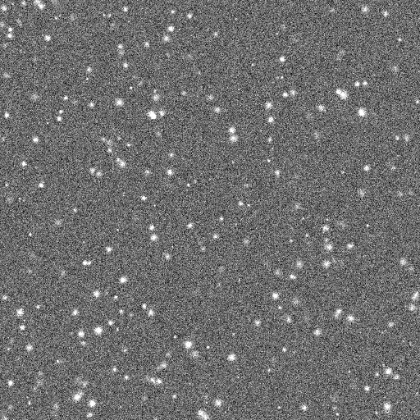
Quiz 4 – Problematic Data set
Open the file in the Quiz 4 folder
List everything that would prevent you tracking the dots accurately

Slide 37
Demo 5 – Trackmate

Slide 38
Challenge 1 – Using TrackMate
Open the Challenge 1 folder – there are two datasets inside.
Track both with TrackMate – which dataset has the higher mean speed?

Slide 39
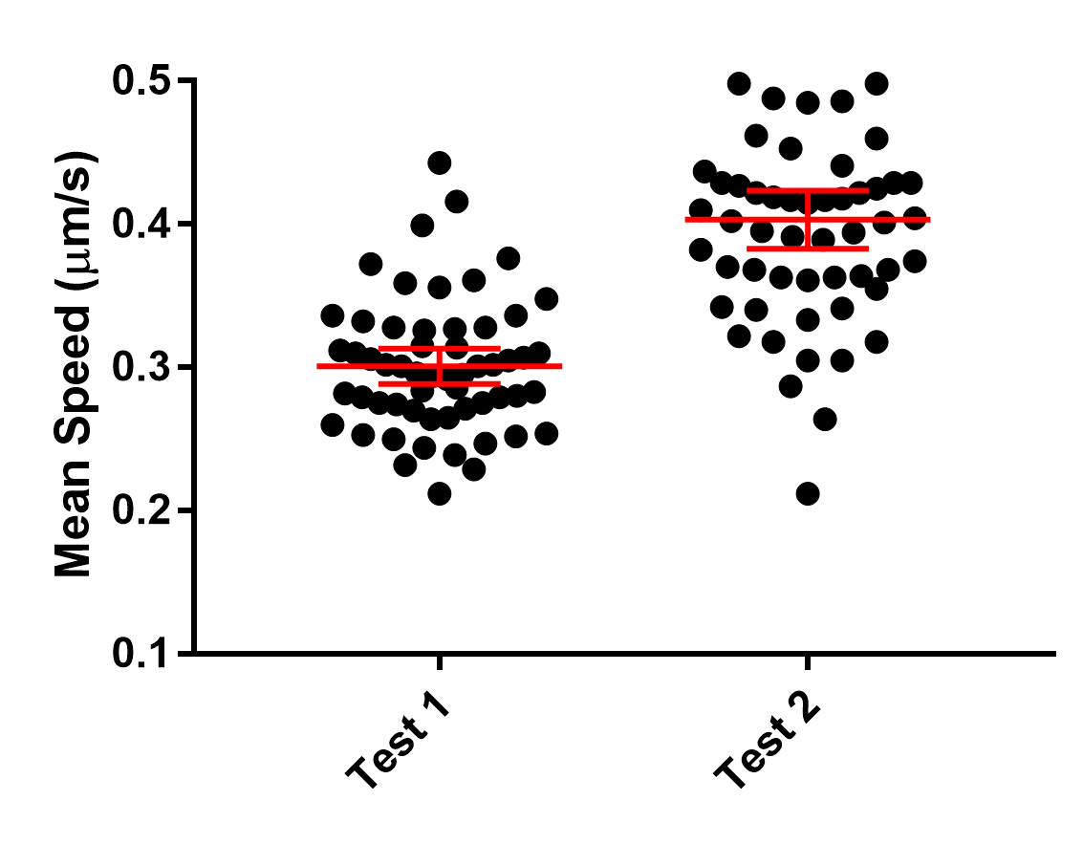

Slide 40
Analysing Trajectories
Once tracked, what numbers can we extract?

Slide 41

Analysing trajectories
t1
Velocity
Instantaneous velocity (v₁, v₂, v₃ … v_{n})
Mean velocity
Directionality
Different definitions
One Example:
Run Length
Velocity may frequently be zero
Intermittent non-zero velocities result in start-stop-start motion
Run length defines distance travelled between “stops”
Mean Square Displacement (MSD)
Δt₁
Δx₁
v₁
t2
Δt₂
Δx₂
v₂
$$\frac{\sum_{i}{\text{Δ}x_{i}} }{Δ\text{X}}$$
ΔT
ΔX
V
t3
Δt₃
Δx₃
v₃
t4

Slide 42
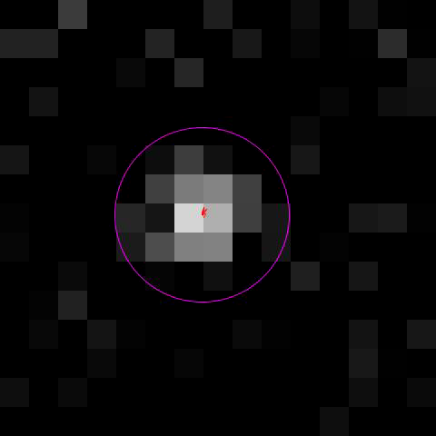
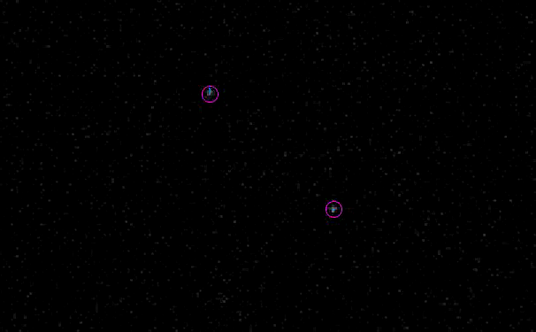
Sources of error
Total displacement
Influenced by localisation error
Stationary particles have non-zero displacement
Velocity
How to deal with “stop-go” motion?
Velocity is rarely zero
Run Length
How to define? What constitutes positive velocity?
Mean Square Displacement
Strongly influenced by noise

Slide 43
Challenge 2 – Interpreting results
Open the Challenge 2 folder – there are three datasets.
Track all with TrackMate - what is mean speed of the particles in each dataset?
Is mean speed the best metric to show differences between the datasets? Can you think of a better metric?

Slide 44
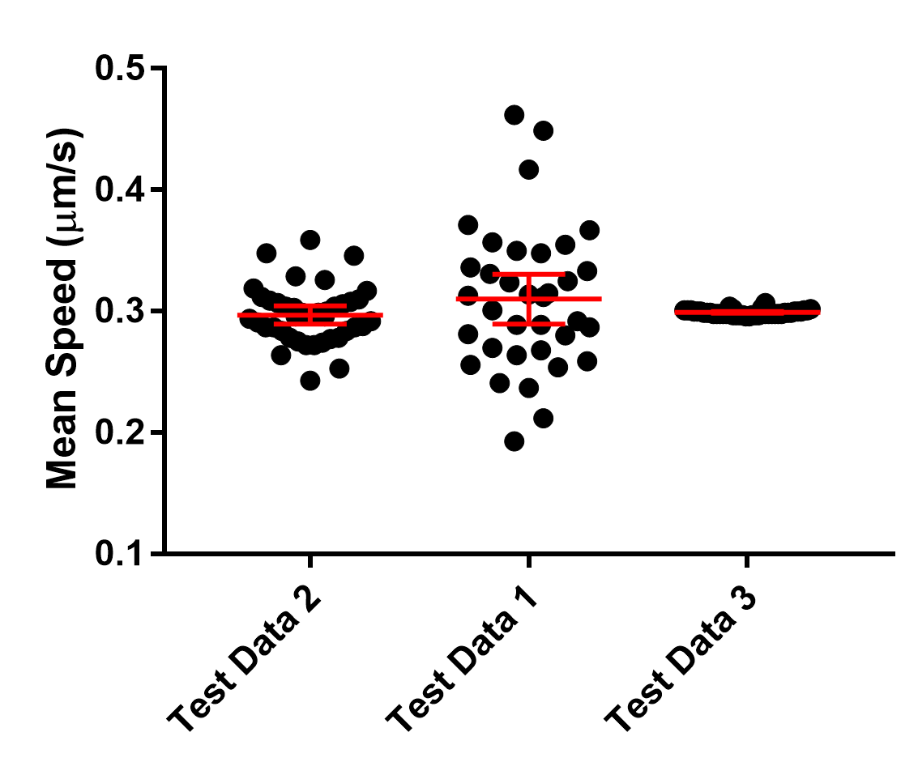

Slide 45
Mean Square Displacement
t2
Δx₂
t5
Δx₁
Δx₂
t3
t1
t4
Δx₃
Δx₄
Δx₁
Δx₁
Characterises nature of motility
Active
Pure Diffusion
Confined

